Slide 1
Non-Verbal Communications
Presented by: Vinayak Bector, Computer Science Student
jvbector@uwaterloo.ca

Slide 2

Introduction
Hi my name’s Vinayak Bector
( 1A CS Student )
But you can call be Bector.
Bector is pronounced the same way you’ll
speak Vector (Quantity with Direction + Mag.)
you just need to replace the sound of ‘V’ with the
sound of ‘B’ .

Slide 3
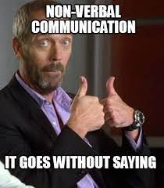
Meme of the day
~ https://www.memecreator.org/

Slide 4
What is Non-verbal Communication
Our textbook, Interplay, defines Non-Verbal Communication as –
“Messages expressed by non-linguistic means”
Non-Linguistic , because it’ll be an oversimplification to state that it is
“communication without words”
Some non-verbal messages have a vocal element. (Voice Modulation)
Non-spoken forms of communication' such as American Sign Language, are linguistic and not really non-verbal.
(These points are taken from our textbook)
Notes:
communication without words." is an oversimplification, vocal communication (by mouth) and verbal communication (with words). Some non-verbal messages have a vocal element. non-spoken forms of communication' such as American Sign Language, are linguistic and not really non-verbal in the

Slide 5
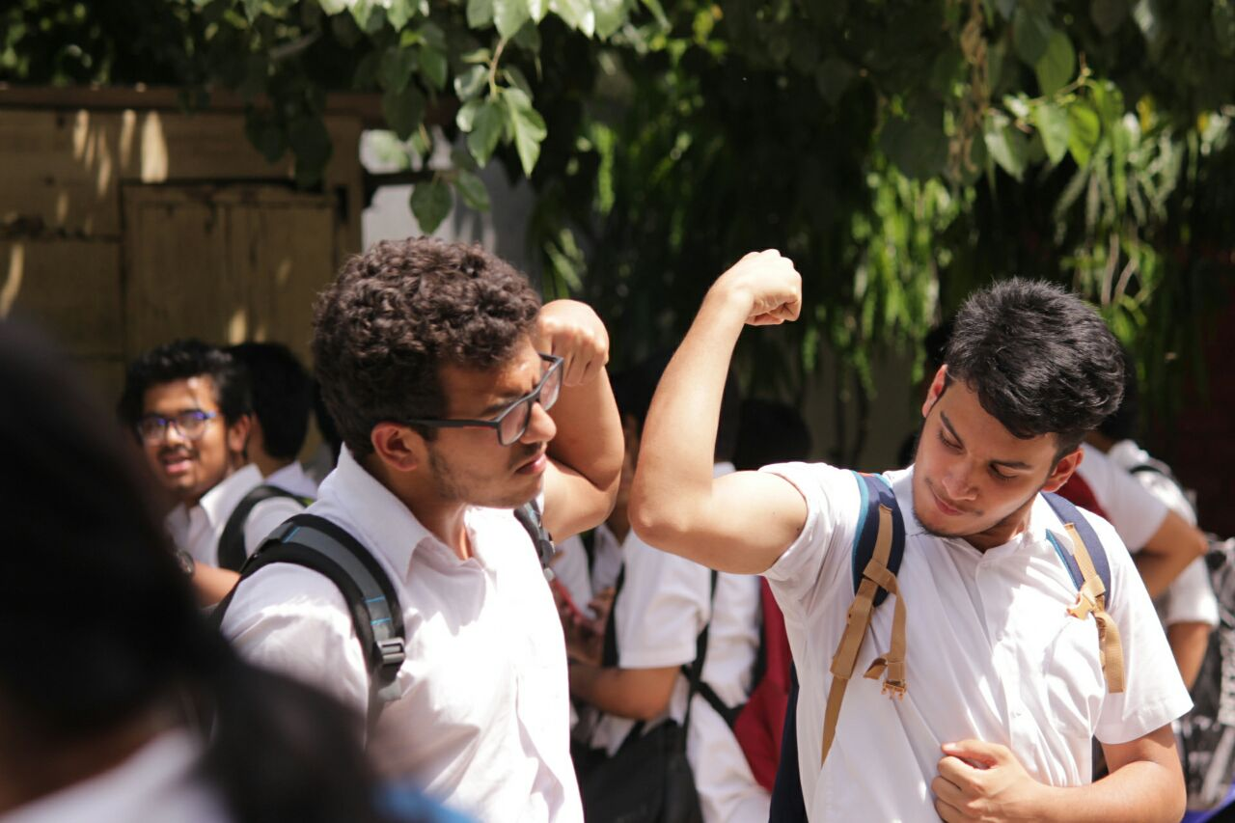
The Picture!
We will analyse and discuss a few non-verbal cues depicted in the following photo:
A photograph of me, on the right-side, and my friend Zohr

Slide 6
Clothes – As a Non-Verbal Cue
Interplay, states that there’re Half-a-dozen types of messages conveyed by what we wear. (Thourlby, 1978)
In this picture, we are asserting our
strength, by the use of our clothes.
Just imagine how one would ,
“Roll up his sleeves” to prepare/indicate
towards the possibility of a fight 😮
Notes:
Clothes are also a very important part of our personality so ..What we wear and how we wear it? Can signal towards a multitude of things! Clothing is one of the most important tool of non-verbal communication. As per our textbook, a finding suggests that there are at least 10 types of messages , like – Economic level, educational level, social position, social background, etc. While posing for this picture, we asserted our strength/ our power by the use of our clothes. Just imagine how one would , “Roll up his sleeves” to prepare/indicate towards the possibility of a fight. However, in this case we just wanted to flex our biceps. How clothes can be used to make a statement.

Slide 7
Facial Expressions
The face and eyes are probably the most noticeable parts of the body, thus can give us a number of non-verbal cues.
Facial expressions are often used to convey
emotions. 😃😛😯😐☹
Eyes themselves can send several kinds of
messages.
How Zohr (the guy on the left), is looking
directly into the camera (which was in front.)
Notes:
Human face is one of the most expressive parts of our body which helps us deliver a plethora of communicative signals, to regulate interactions and establish connections. We also use are face to convey emotions, how we smile when we are happy, frown when we are sad and so on. The fact by using emoji (which are digital manifestations of our facial expression) can help us articulate our thoughts/emotions/feelings. Our eyes themselves can send numerous signals. Looking directly into the camera in front of us, And yeah I should take this moment to explain that there were actually two cameras. There was a camera directly in front of us and another camera from which this picture was taken.
So, by looking directly into the camera in front of us, Zohr is probably trying to give a message that he is a “fearless soul”. BUT WAIT THERE’s more, I don’t know if you have noticed it or not. But, there’s one more guy in the picture who is very aptly using his face to express his emotions. Nope it’s not me. Let’s zoom in a little bit

Slide 8

Re-contextualizing disability
He is probably thinking, What’s going on?
Notes:
Hahahahahah
So this is Rohan, and just by looking at his face, you can tell very easily that he’s probably thinking “What’s going on?”. And by using these examples I hope I was able to help you understand how crucial facial expressions are in our ability to communicate with people around us.

Slide 9
Summary
Non-verbal communication consists of messages expressed by non-linguistic means
Non-verbal messages can be communicated in a variety of ways-through the face and eyes as well as our clothes
Facial Expression – How the human face is one of the most expressive parts of our body which helps us deliver a plethora of communicative signals, to regulate interactions and establish connections.
Clothes - What we wear and how we wear it? Can signal towards a multitude of things!

Slide 10

References
Interplay (Oxford textbook)– Definitions of various terminologies
Body Language– by Allen Pease, discusses in length how a person’s gestures accurately indicate emotions/thoughts/desires.
The Dictionary of Body Language – by Joe Navarro, who is (Retd) FBI Special Agent.

Slide 11
Thank you!

